Slide 1
Status update

Slide 2
Things I have done since last time
Improved the general command detect algorithm
Designed grammatical stacks for word analysis
Found another relevant NLP task called dependency parsing
Changed rapport a bit according to feedback
Probably not relevant, but I spent time on it
Created a github
Bought I microphone (tested python voice to text module using speechRecognizer)
Put my virtual machine on an external harddrive because Standford_coreNLP is huge

Slide 3
General improvement of command detection
Commands can now be any length, as long as they appear in the correct .txt file.

Slide 4
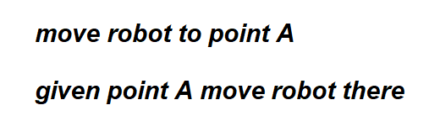
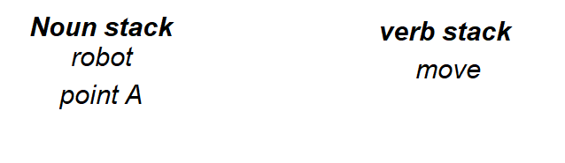
Noun and verb stack

Slide 5
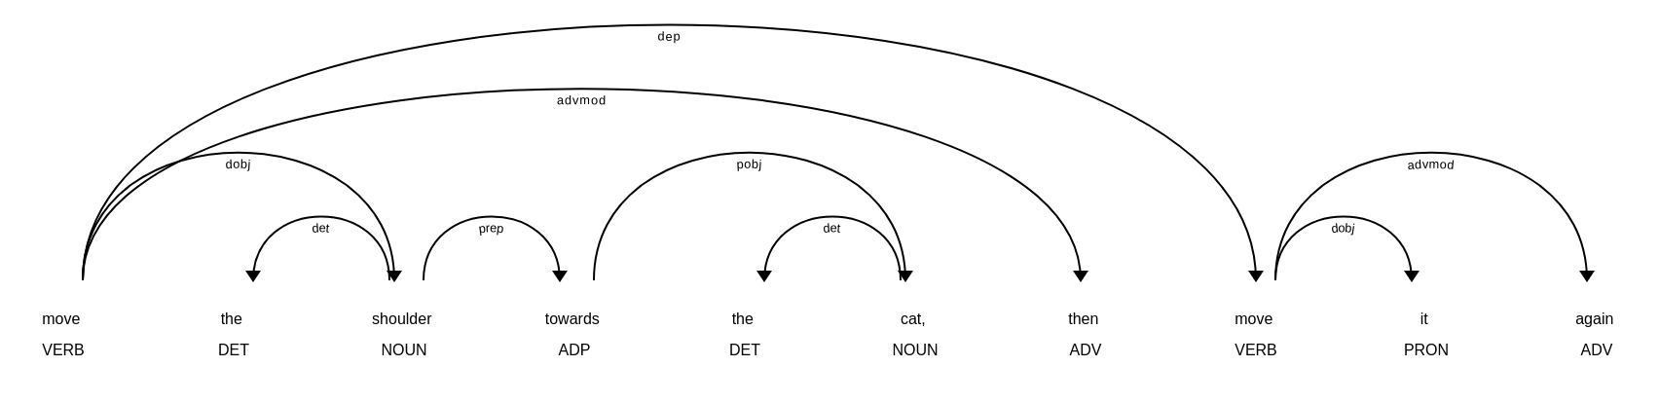
Dependency parsing

Slide 6
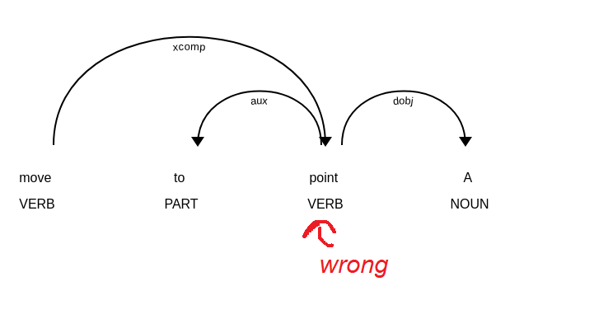
Dependency parsing

Slide 7
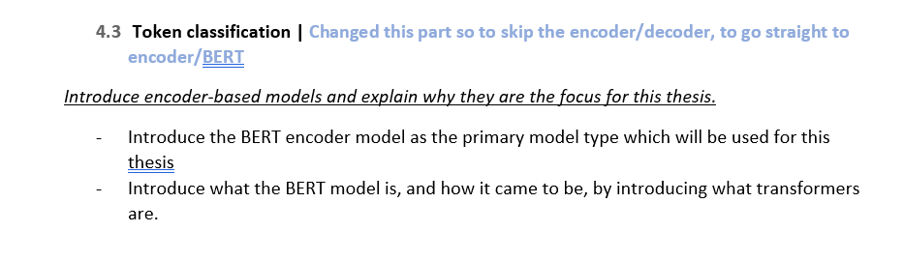
rapport
Deleted basic NN introduction
Deleted discriminative models
Changed encoder/decoder:

Slide 8
Dependency parsing
Spacy – implemented in python, not used in command detection
Standford core NLP – downloaded but not implemented in python
Stanza – plan on using this, but have not downloaded it yet.

Slide 9
The other stuff I spent time on
Created Github.
Bought a nice microphone.
Put virtual machine into an external hard drive to give it 150 Gb space.

Slide 10
Microphone part
Very probable, that voice to text generally is significantly error prone.

